Slide 1
Exam2 (Final) Overview
Basic Information

Slide 2
Exam Date and Time
Date: Thursday, December 8th
Time: 4pm – 5:15 pm
Place: 138 Class Room

Slide 3
Exam Specifications
1hour 15minutes long
Closed book/notes
Multiple choice
Guess
×

Slide 4
What You Need To Bring to Exam 2
NCS Form 4521
big, blue / purple
available in the Hornet Bookstore and Union Store
Number 2 Pencil Only
Very Good ERASER

Slide 5
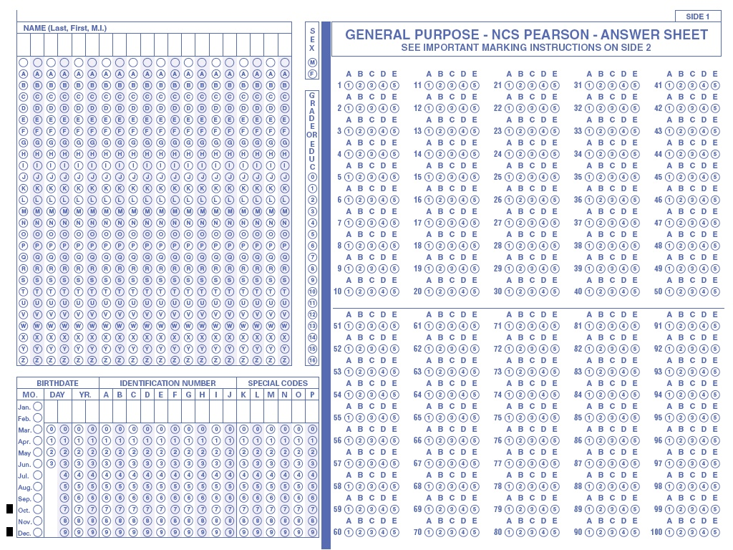
NCS Pearson 4521

Slide 6
What You Need for the Exam - Reference Sheet
One 8 ½" x 11"
Two Sides
Hand-written or Typed!
No photocopies
You will leave it with the exam

Slide 7
Exam2 (Final) Review
Exam2 Study Guide – will cover material after Exam1.

Slide 8
Chapter 3 – Transport Layer 3: Important to Know
TCP which fields are used to implement following and how:
Sequence Numbers: Purpose and how they are used
Error Control: Checksum, what is checked by Checksum, protocols (Go-Back-N,) … , etc,
Flow control (sliding window):
Window Advertisement,
Congestion Control (Time to Live == TTL)

Slide 9
Chapter 3 – Transport Layer 4: Important to Know
TCP which fields are used to implement following and how:
Connection management: Handshake protocols,
Congestion Control: Principles, AIMD, Slow Start, TCP Tahoe, TCP Reno, etc.
UDP. Difference with TCP.
When to use TCP or UDP and why.
TCP Timers. Dynamic timer calculation

Slide 10
Chapter 3 – Transport Layer 4: Don't Worry About
Detailed packet format for transport protocols but should know the fields and functions
Timer calculation detailed formulas involving standard deviation but must understand components of the basic dynamic timer formula

Slide 11
Chapter 4– Network Layer 2: Important to Know
Forwarding and Routing
Network Service Models: Best Effort and Guaranteed Delivery.
Datagrams vs Virtual Circuits

Slide 12
Chapter 4– Network Layer 3: Important to Know
Router Internals: Input, Switch Fabric, Output
Internet Protocol (IPv4): Header Information, the purpose of the various fields and units of measure as applicable.
Addressing, forwarding, hierarchy
Fragmentation and Reassembly and calculations
Error checking
Options fields mentioned (eg source routing, record route, etc)

Slide 13
Chapter 4– Network Layer 4: Important to Know
Internet Protocol (IPv4) Addressing Issues:
Subnets, CIDR,
NAT advantages and limitations.
DHCP, its purpose, and how it works
ICMP, its purpose and uses
Introduction to IPv6 at the level covered at lectures. Brief comparison with IPv4
Tunneling. Its purpose, IP in IP tunnels

Slide 14
Chapter 4– Network Layer 5: Don't Worry About
Detailed packet format for IP protocol but should know the fields and functions
Any details not covered during lecture.

Slide 15
Chapter 4– Network Layer 6: Important to Know if covered
Routing Algorithms
Distance-Vector (Bellman-Ford)
Link-State (Dijkstra)
Given a network topology with costs of links be able to implement the algorithm
Corresponding routing protocols: RIP, OSPF, BGP
Hierarchical Routing: Advantages, Autonomous Systems, etc.

Slide 16
Chapter 5– Link Layer 1 Important to Know
Purpose of Link Layer
Error Detection and Retransmission
Forward Error Correction
Parity Check: 1 and 2 Dimensions, CRC representation with polynomials.
Given data, be able to determine parity bits

Slide 17
Chapter 5– Link Layer 2 Important to Know
Error detection properties ie. The kinds of errors that can be detected.
Given Data bits and Generator polynomial, be able to determine appropriate error checking (CRC) bits.

Slide 18
Chapter 5– Link Layer 3: Important to Know
Multiple Access Networks: LANs, Wireless/Radio, Satellites, and their properties.
Multiple Access Protocols
Channel Partitioning: TDMA, FDMA
Random Access: S-Aloha, CSMA, CSMA/CD, CSMA/CA
Taking-Turns Protocols: Token passing, Reservation

Slide 19
Chapter 5– Link Layer 4 Important to Know
Link Layer Protocols: Ethernet (IEEE 802.3), frame format fields
Switched LANs: why switches have replaced buses in current Ethernet LANs. VLANs.
Difference between switches and routers.
Address Resolution Protocol (ARP), Learning
Given a network application (eg. Web) Be able to determine details of events, including appropriate protocols invoked in various layers

Slide 20
Chapter 6 – Wireless and Mobile Nets Important to Know
SOME OF THESE MAY BE SKIPPED. DECISION WILL BE MADE IN CLASS
Wireless Links
General Wireless Network Architecture
802.11 (WiFi) standard
Cellular Networks (1G/2G/3G/4G)
Mobility Issues.

Slide 21
How To Study for the Exam2 (Final)
Go through homework problems
Go through lecture notes (slides on SacCT plus clarifying comments from class).
Go through study questions assigned
Prepare for the exam as if it is a closed book and closed notes exam even though you are allowed sheet of notes

Slide 22
Good Luck on the Exam!

